Slide 1
Get Help App (Showcase)
By Team Starneo

Slide 2
Prototype Design
The following app protypes were made using draw.io.
The app will follow a simple and intuitive layout.
Pictures will be used in almost every page, representing actions and providing the user with helpful cues.

Slide 3
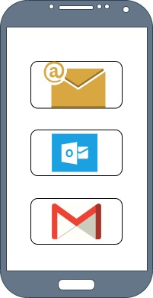
Login/Register Page
Will allow the user to sign in.
Grants the user the ability to register using
various existing email providers.

Slide 4
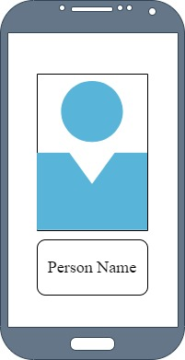
Profile Display Page
A profile display page will appear for every
successful login.
Displays the user’s information.

Slide 5
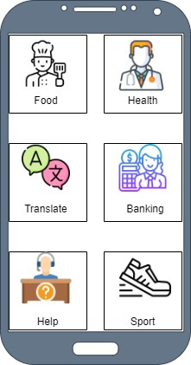
Help Categories Page
The user will be able to select what help category they’re looking for.
Once the category is chosen they are
forwarded to available experts.

Slide 6
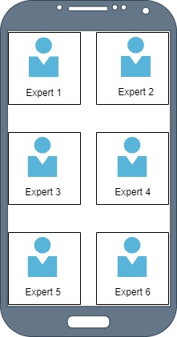
Available Experts Page
A list of experts will be available for the user to choose from.
A picture along with the expert’s name will be shown.

Slide 7
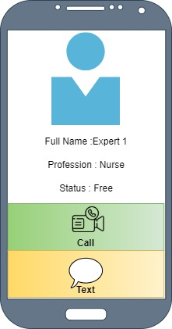
Expert Details Page
When an expert is chosen their availability status is shown.
An option will be available to contact them via text or audio.

Slide 8
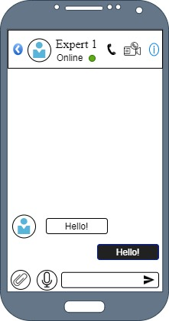
Message Page
If the user chooses to message instead, a chat box will appear.
Basic functionalities available:
Able to attach files.
Send voice recording.
Send pictures and videos.

Slide 9
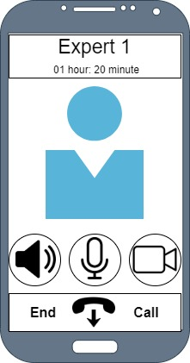
Call Page
If the user chooses to call, a call information pop up will appear.
Basic functionalities available:
Mute button
Loudspeaker button
Video button

